Slide 1
Hospital
By: Logan, Braden, Colton, and Connor

Slide 2
Project Description
This database will be used by hospital staff to manage some daily functions of a single hospital. It will store the basic information about each patient, including an emergency contact, where they are located, what appointments they have made, and what medicines they have been prescribed. The doctors that appointments are made with and the medicines they have prescribed to patients are also tracked. The database also tracks what department each nurse and doctor are in, and what room each nurse is assigned to.

Slide 3
Statement of Requirements
This database is to manage some of the daily functions of a single hospital.
Show which doctors have appointments with a patient
Track appointment information
Store list of doctors that work in each department
Store list of nurses that work in each department
Store prescriptions, the patient it is prescribed for and the doctor that prescribed it
Track if rooms in each department have a patient in them
Store an emergency contact for each patient
Store personal information about each doctor
Store personal information about each nurse
Store personal information about each patient

Slide 4
Data
Out of scope data: inventory of medical supplies, inventory of prescriptions, financial information, insurance
In scope data: Patient information, appointment dates and times, doctor for each appointment, prescriptions, department information, room information, nurse and doctor personal information

Slide 5
Reports Required
A report that shows how many prescriptions each doctor has prescribed
A report that shows what patients are in each room, and the nurse that is assigned to that room
A report that shows which nurse is in each department
A report that shows which doctor is in each department
A report that shows the drug prescribed for each patient
A report that shows which doctor is assigned to which patient
A report that shows the emergency contact information for each patient
A report that shows the appointment information for each patient

Slide 6
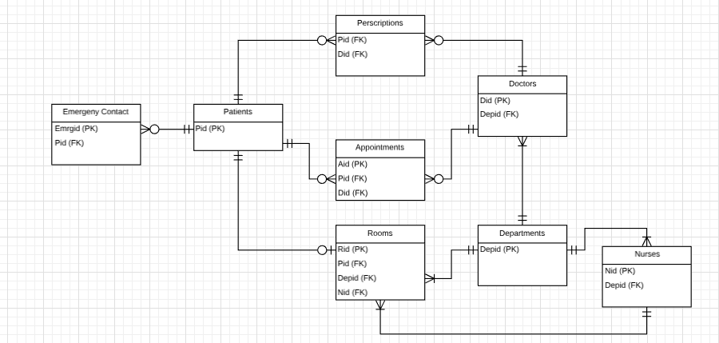
ERD

Slide 7
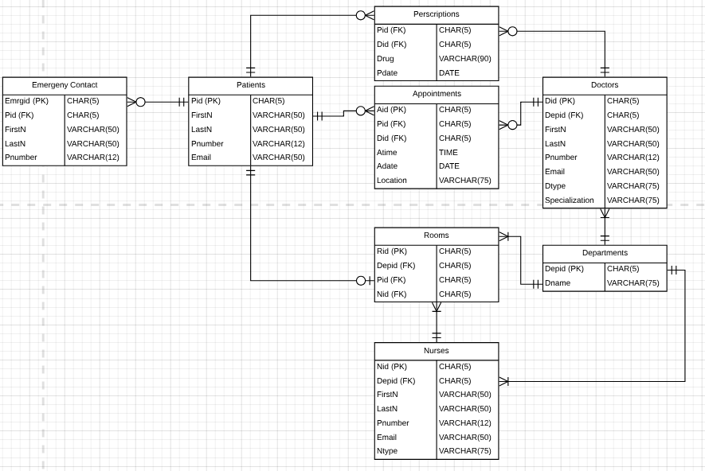
RDM

Slide 8
DDL Statements
CREATE TABLE Patients (
Pid CHAR(5) not null,
FirstN VARCHAR(50) not null,
LastN VARCHAR(50) not null,
Pnumber VARCHAR(12),
Email VARCHAR(50),
PRIMARY KEY (Pid)
);
CREATE TABLE Emergency_Contact (
Emergid CHAR(5) not null,
Pid CHAR(5) not null,
FirstN VARCHAR(50) not null,
LastN VARCHAR(50) not null,
Pnumber VARCHAR(12) not null,
PRIMARY KEY (Emergid),
Foreign Key (Pid) References Patients(Pid)
);

Slide 9
DDL Statements
CREATE TABLE Departments (
Depid CHAR(5) not null,
Dname VARCHAR(75) not null,
PRIMARY KEY (Depid)
);
CREATE TABLE Doctors (
Did CHAR(5) not null,
Depid CHAR(5) not null,
FirstN VARCHAR(50) not null,
LastN VARCHAR(50) not null,
Pnumber VARCHAR(12),
Email VARCHAR(50),
Dtype VARCHAR(75),
Specialization VARCHAR(75),
PRIMARY KEY (Did),
Foreign Key (Depid) References Departments(Depid)
);

Slide 10
DDL Statements
CREATE TABLE Nurses(
Nid CHAR(5) not null,
Depid CHAR(5) not null,
FirstN VARCHAR(50) not null,
LastN VARCHAR(50) not null,
Pnumber VARCHAR(12),
Email VARCHAR(50),
Ntype VARCHAR(75),
PRIMARY KEY (Nid),
Foreign Key (Depid) References Departments(Depid)
);
CREATE TABLE Rooms(
Rid CHAR(5) not null,
Depid CHAR(5) not null,
Pid CHAR(5),
Nid CHAR(5)
PRIMARY KEY (Rid),
Foreign Key (Pid) References Patients (Pid),
Foreign Key (Depid) References Departments(Depid),
Foreign Key (Nid) References Nurses(Nid)
);

Slide 11
DDL Statements
CREATE TABLE Appointments(
Aid CHAR(5) not null,
Pid CHAR(5) not null,
Did CHAR(5) not null,
Atime Time not null,
Adate DATE not null,
Location VARCHAR(75),
PRIMARY KEY (Aid),
Foreign Key (Pid) References Patients(Pid),
Foreign Key (Did) References Doctors(Did)
);
CREATE TABLE Prescriptions(
Pid CHAR(5) not null,
Did CHAR(5) not null,
Drug VARCHAR(90) not null,
Pdate DATE not null,
Foreign Key (Pid) References Patients (Pid),
Foreign Key (Did) References Doctors(Did)
);

Slide 12
DML Statements
PATIENTS INSERTS
INSERT INTO Patients
VALUES ('P0012', 'John', 'Smith', '202-555-0106', 'jsmith@yahoo.com')
INSERT INTO Patients
VALUES ('P0044', 'Michael', 'Wilson', '208-736-9100', 'mikew@gmail.com')
INSERT INTO Patients
VALUES ('P0129', 'Brenda', 'Johnson', '360-807-3365', 'brendajohnson@hotmail.com')
EMERGENCY INSERTS
VALUES ('E0018', 'P0044', 'Linda', 'Smith', '202-269-1183')
INSERT INTO Emergency_Contact
VALUES ('E0111', 'P0129', 'Jacob', 'Wilson', '208-721-9179')
INSERT INTO Emergency_Contact
VALUES ('E0012', 'P0012', 'Mark', 'Johnson', '360-451-1632')
DEPARTMENT INSERTS
INSERT INTO Departments (Depid, Dname)
VALUES ('M0001','Surgery')
INSERT INTO Departments (Depid, Dname)
VALUES ('M0002','Emergency Room')
INSERT INTO Departments (Depid, Dname)
VALUES ('M0003','Intensive Care Unit')
DOCTORS INSERTS
INSERT INTO Doctors
VALUES ('D0001', 'M0002', 'Dan', 'Williams', '214-919-5893', 'drdwilliams@gmail.com', 'Family Physician', 'orthopedics')
INSERT INTO Doctors
VALUES ('D0002', 'M0001', 'Steve', 'Miller', '713-080-0071', 'smiller@gmail.com', 'Cardiologist', 'Clinical cardiac electrophysiology')
INSERT INTO Doctors
VALUES ('D0003', 'M0003', 'Sarah', 'Jones', '823-517-7410', 'drjones@gmail.com', 'Family Physician', 'orthopedics')

Slide 13
DML Statements
NURSES INSERTS
INSERT INTO Nurses
VALUES ('N0001', 'M0002', 'Rachel', 'Moore', '343-986-0123', 'rmoore@gmail.com', 'Registered Nurse')
INSERT INTO Nurses
VALUES ('N0002', 'M0001', 'Katy', 'Bell', '123-456-7890', 'katyb@gmail.com', 'Operating Room Nurse')
INSERT INTO Nurses
VALUES ('N0003', 'M0003', 'Samantha', 'Young', '222-845-1900', 'syoung@gmail.com', 'Clinical Nurse Specialist')
ROOMS INSERTS
INSERT INTO Rooms
VALUES ('R0130', 'M0001', 'P0044', 'N0002')
INSERT INTO Rooms
VALUES ('R0215','M0002', 'P0129', 'N0002')
INSERT INTO Rooms
VALUES ('R0419','M0003', 'P0012', 'N0003')
PRESCRIPTIONS INSERTS
INSERT INTO Prescriptions
VALUES ('P0044', 'D0001', 'Amphetamine', '10/14/2018')
INSERT INTO Prescriptions
VALUES ('P0044', 'D0001','Hydrocodone', '10/15/2018')
INSERT INTO Prescriptions
VALUES ('P0044', 'D0001','Amoxicillin', '10/17/2018')
INSERT INTO Prescriptions
VALUES ('P0129', 'D0002','Amoxicillin', '10/12/2018')
INSERT INTO Prescriptions
VALUES ('P0012', 'D0003','Amoxicillin', '10/14/2018')

Slide 14
DML Statements
APPOINTMENTS INSERTS
INSERT INTO Appointments
VALUES ('A0001', 'P0044', 'D0001', '09:30:00', '10/14/2018', 'Waiting Area 1')
INSERT INTO Appointments
VALUES ('A0002', 'P0044', 'D0001', '11:00:00', '10/11/2018', 'Waiting Area 1')
INSERT INTO Appointments
VALUES ('A0003', 'P0044', 'D0001', '12:30:00', '10/15/2018', 'Waiting Area 2')
INSERT INTO Appointments
VALUES ('A0004', 'P0129', 'D0002', '08:00:00', '10/12/2018', 'Waiting Area 4')
INSERT INTO Appointments
VALUES ('A0005', 'P0012', 'D0003', '09:00:00', '10/13/2018', 'Waiting Area 2')

Slide 15
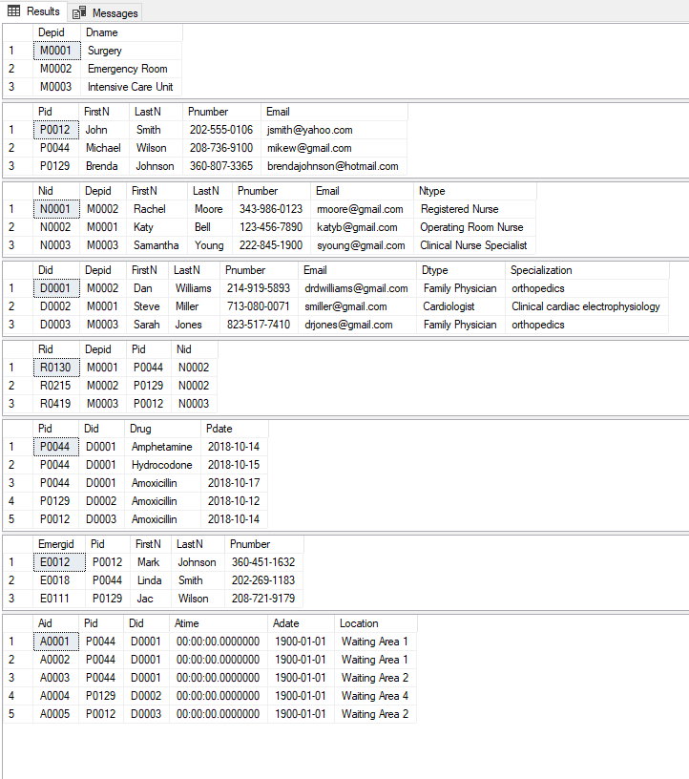
Screen Print

Slide 16
Queries
Shows patient names, department room is in, room number, and the nurse assigned to the room for patients that are rooms.
SELECT Patients.FirstN, Patients.LastN, Rooms.Depid, Rooms.Rid, Rooms.Nid FROM Patients INNER JOIN Rooms on Patients.Pid=Rooms.Pid;
Shows the number of prescriptions each doctor has prescribed, and there name and id.
SELECT count(Prescriptions.Did) AS PrescriptionsGiven, Doctors.FirstN, Doctors.LastN, Doctors.Did FROM Prescriptions, Doctors WHERE Doctors.Did=Prescriptions.Did GROUP BY Doctors.Did, Doctors.FirstN, Doctors.LastN;

Slide 17
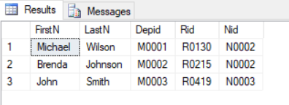
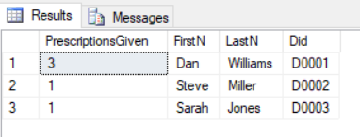
Screenshots of Queries

Slide 18
Queries
Shows which doctor is in each department
SELECT Doctors.FirstN, Doctors.LastN, Doctors.Depid, Departments.Dname FROM Doctors INNER JOIN Departments on Doctors.Depid= Departments.Depid;
Shows which nurse is in each department
SELECT Nurses.FirstN, Nurses.LastN, Nurses.Depid, Departments.Dname FROM Nurses INNER JOIN Departments on Departments.Depid= Nurses.Depid;

Slide 19

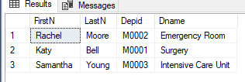
Screenshots of Queries

Slide 20
Queries
Shows which doctor is assigned to which patient:
SELECT Doctors.LastN as Doctor , patients.lastN as Patient
FROM Doctors JOIN Departments on Doctors.depid= departments.depid
Join rooms on departments.depid = rooms.depid JOIN patients ON rooms.Pid = patients.pid;
Shows each patient’s drug:
SELECT patients.lastN as Patient, prescriptions.drug
FROM patients JOIN prescriptions on patients.pid= prescriptions.pid;

Slide 21
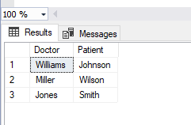
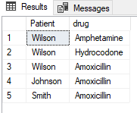
Screenshots of Queries

Slide 22
Queries
Shows emergency contact information for each patient
SELECT p.LastN, e.FirstN, e.LastN, e.Pnumber
FROM Patients as p
INNER JOIN Emergency_Contact as e ON p.Pid = e.Pid;
Shows appointment information
SELECT p.FirstN, p.LastN, a.Adate, a.Atime, a.Location, d.LastN
FROM Patients as p
INNER JOIN Appointments as a ON p.Pid = a.Pid
INNER JOIN Doctors as d ON a.Did = d.Did;

Slide 23
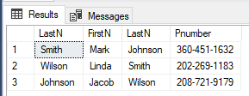
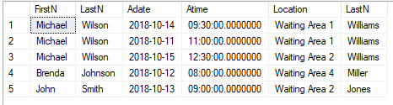
Screenshots of Queries

Slide 24
Thank you

